Slide 1
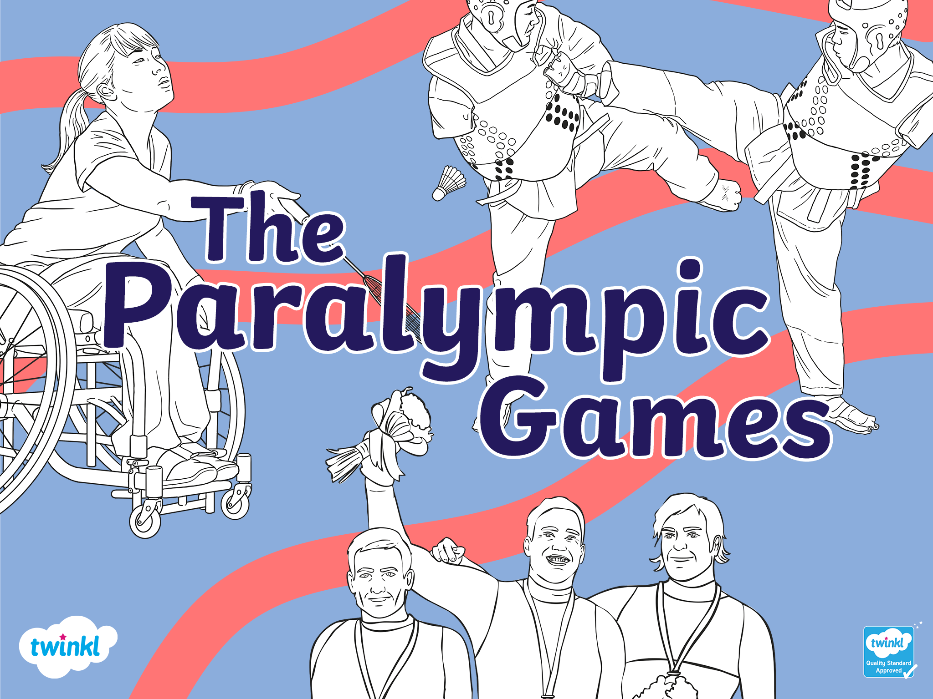

Slide 2

What Are the Paralympic Games?
The Paralympic Games are an international competition where athletes from all over the world compete.
What makes the Paralympics unique is that all the athletes have some form of physical, visual or intellectual difference to the athletes who participate in the Olympic Games. These impairments may disadvantage an athlete.
Some people call these differences ‘disabilities’, while others prefer alternative phrasing.
While the Olympic Games are held every four years in summer, the Paralympic Games take place every two years, alternating between Winter Games and Summer Games. Since the late 20th century, the Paralympics have been held in the same city that hosts the Olympic Games.

Slide 3

When Did the Paralympic Games Start?
On 29th July 1948, Dr. Guttmann, an English neurosurgeon and the founder of the Paralympic Games, organised a competition for wheelchair athletes.
In this competition, Second World War veterans with spinal cord injuries took part in archery.

Slide 4
When Did the Paralympic Games Start?
He named the competition ‘the Stoke Mandeville Games’, which later became the Paralympic Games. They took place in 1960 in Rome, with 400 athletes from 23 countries taking part.

Slide 5

Taking Part in the Paralympic Games
In the Paralympic Games, athletes with visual, physical and/or intellectual impairments all have the opportunity to compete.
These impairments can lead to a competitive disadvantage, so a system has been put in place to ensure that all competitors have the best opportunity to succeed.

Slide 6
Taking Part in the Paralympic Games
This system is called ‘classification’ and it ensures that the athlete’s success is determined by their skill, mental focus, power, fitness and endurance.
You can find out more about the Paralympic Games classifications here.

Slide 7

Classification of Impairments
The impairments which Paralympic athletes might experience are classified into the following categories:
impaired muscle power
impaired passive range of movement
limb deficiency
leg length difference
short stature
muscle tension
uncoordinated movement
involuntary movements
intellectual impairment
vision impairment
What do you think these things mean? You can find out more about the Classification System for athletes competing in the Paralympic Games here.

Slide 8
What Sports Do Athletes Complete in?
There are a huge variety of sports which Paralympic athletes can participate in, with some of them being found in the Olympic Games too.
Some of the sports in the Paralympic Games are:
badminton, equestrian, football
canoeing, judo, triathlon
skiing, swimming, tennis
archery, fencing, boccia

Slide 9
Scottish Paralympians
This year, the Tokyo 2020 Paralympic Games will begin on the 24th August and finish on the 5th September 2021.
Thousands of athletes from around the world are going to be competing. Participating among them are two Scottish Paralympians, Maria Lyle and Jo Butterfield. They will be representing the Great Britain team.

Slide 10

Maria Lyle
Maria Lyle is a parasport athlete from Scotland, who will be competing in T35 running events. T35 events are part of the classification system for the paralympics. The ‘T’ stands for ‘track’ events, like running.
‘35’ is the classification of disability. If an athlete meets a classification between 35 and 38, it means that they are recognised to have difficulties co-ordinating their body.

Slide 11
Maria Lyle
Lyle was born in 2000 in Dunbar, Scotland. She began running at the age of nine. From the age of 14, she began competing in major sporting events and has won numerous medals. Her successes include bronze, silver, and gold medals.
She has taken part in European Championships, World Championships and Paralympic Games, representing Great Britain. She usually participates in 100m, 200m and relay races.
Lyle was born with Cerebral Palsy. It is a permanent disorder which impacts the way the body moves. Every case is different but Lyle has not allowed her diagnosis stop her from achieving huge success in sport.

Slide 12
Jo
Butterfield
Jo Butterfield is a parasport athlete who competes in the F51 club and discus throw. “F’ stands for ‘field’ sports, such as discus, shot put and javelin.
‘51’ means that Butterfield falls into a category for athletes who participate in seated throws. Athletes may have slightly decreased power in their upper body and do not have muscle power in the trunk area of their body.
Butterfield was born in Yorkshire, England and later moved to Glasgow, Scotland. She was diagnosed with a spinal tumor, which resulted in her being paralysed below the waist.

Slide 13
Jo
Butterfield
Butterfield is a former army civil servant. She first tried wheelchair basketball and transitioned to field events. She had great success at club throwing, winning gold medals several times, including at the Paralympic Games in Rio in 2016.
Jo Butterfield was appointed Member of the Order of the British Empire (MBE) in 2017.

Slide 14
